Slide 1
Analysis and Prediction of
Airline Passenger Satisfaction
Group 15
Qian Zhang, Yeling Cai, Yunhan Zhang, Zekai Wei

Slide 2
TABLE OF CONTENTS
1. Data Overview
Interpretation and discovery of raw data.
2. Exploratory Data Analysis
Explore and visualize data to learn more about it.
3. Prediction
Logic Regression, Random Forest, GBT Regression, Neural Network.
4. Inference
Based on the results of the modeling, the inferences made.
5. Conclusion
Project conclusion and summary of learnings.

Slide 3

Data Overview
Description
The dataset records 129,880 American Airlines passenger satisfaction surveys, with one column for satisfaction ratings and 22 for explanatory variables which contain customer type and service surveys on the flight.
Raw data set: 129,880 rows, 24 cols.
Sample predictors
Gender: Gender of the passengers (Female, Male)
Type of Travel: Purpose of the flight of the passengers (Personal Travel, Business Travel)
Class: Travel class in the plane of the passengers (Business, Eco, Eco Plus)
Customer Type: The customer type (Loyal customer, disloyal customer)
Flight distance: The flight distance of this journey
Satisfaction: Airline satisfaction level (0-5 score; including Wifi service, Food and drink, Seat comfort, etc.)

Slide 4
Anything interesting or surprising about the data
The First thing
This dataset describes nearly every aspect of the experience of flying with a passenger. Through this data set, more detailed factors can be provided to help airlines improve their services in a targeted manner.
The Second thing
The average score of seat comfort is the lowest, 2.84, which means many passengers are not satisfied with seats on the plane. Therefore, maybe the quality of seats is the most important problem to be concerned about.
The third thing
50% of Departure Delay in Minutes and Arrival Delay in Minutes are 0, and 75% of both are around 12, but the average delay are around 15 minutes. This shows that the flight took off normally in most cases, but because some extreme delays occurred, the data showed this trend.

Slide 5
EXPLORATORY DATA ANALYSIS

Slide 6
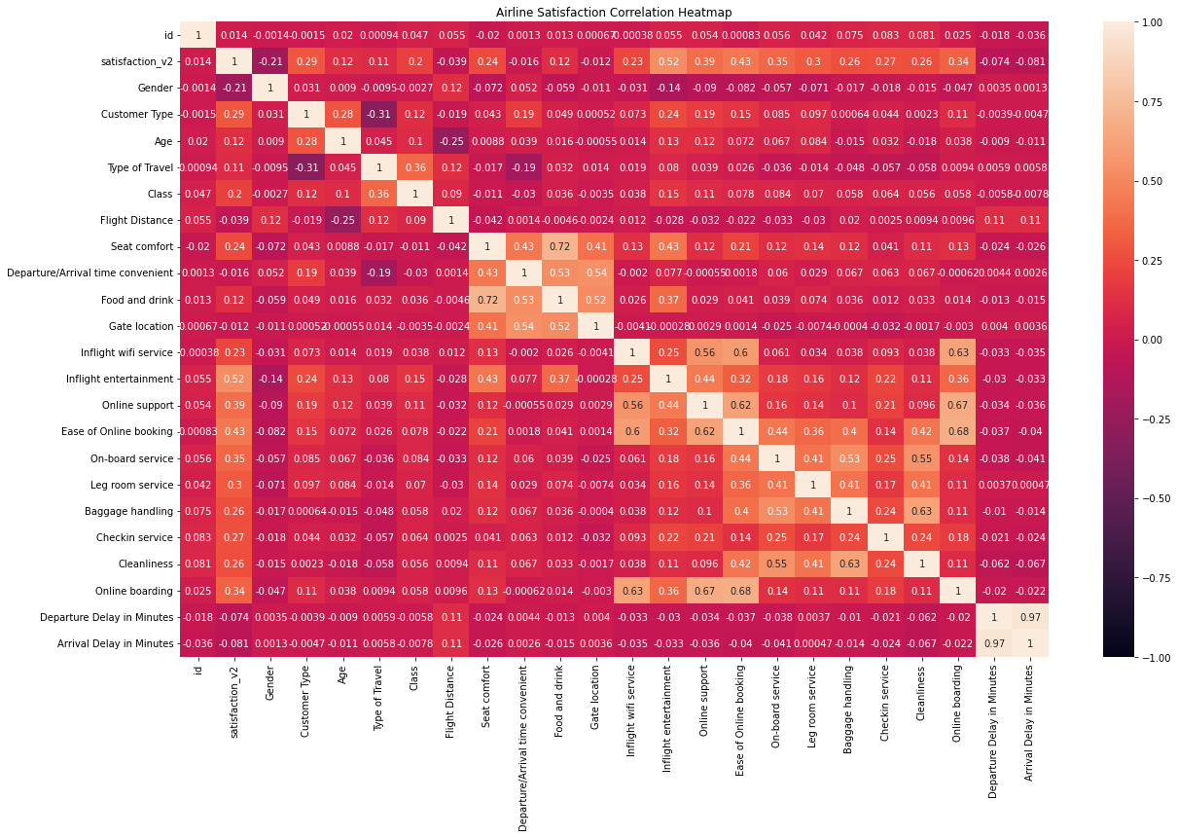
Exploratory Data Analysis 1
We did a preliminary exploration of the data, we found that in the satisfaction survey, nearly 55% of passengers (71,087 people) were satisfied with the flight experience. According to the left figure, it can be found that Inflight Entertainment has the greatest impact on customer satisfaction with 0.52, followed by Ease of Online Booking, Online Support, On-board Service, and Online Boarding. The above variables are positively correlated with customer satisfaction. In Customer Type, we found that the Type of Travel had a large correlation of -0.31. That said, customers with more personal travel are generally more loyal.

Slide 7
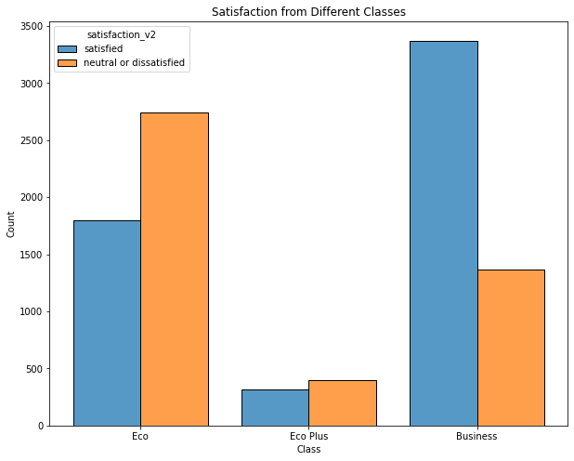
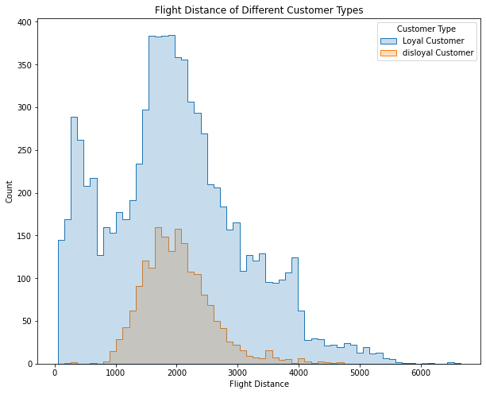
Exploratory Data Analysis 2

Slide 8
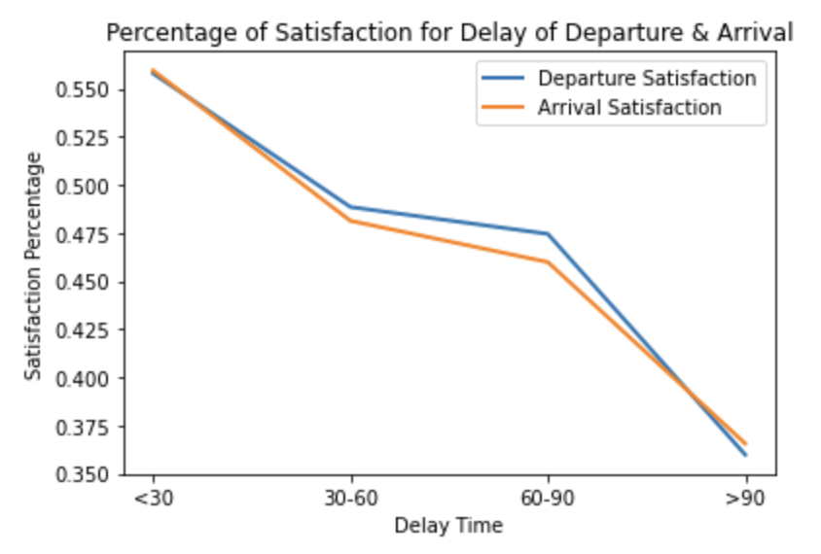
Exploratory Data Analysis 3

Slide 9

PREDICTION & INFERENCE

Slide 10
Model Prediction 1
Goal: We want to predict passengers’ overall satisfaction to help airline leaders decide how to improve service quality.
Value being predicted: Overall Satisfaction
Predictors: Gender, Customer Type, Age, Travel Type, Class, Flight Distance, Departure Delay in Minutes, Arrival Delay in Minutes, and 14 Sub-satisfaction Scores (Seat comfort, Wifi service, Food and drink, etc.)

Slide 11
Model Prediction 1 - Predict satisfaction
Model type | Scoring metric | Number of folds (Cross validation) | Resulting model score
Logic Regression | AUC | 3 | 0.9130
Random Forest | AUC | NA | 0.9833
GBT Regression | AUC | NA | 0.9810
Neural Network | AUC | 3 | 0.5232

Slide 12
Model Prediction 2
Goal: We want to predict passengers’ overall satisfaction to find the relationship between sub-satisfaction and overall satisfaction, then get the importance of each metric.
Value being predicted: Overall Satisfaction
Predictors: 14 Sub-satisfaction Scores (Seat comfort, Wifi service, Food and drink, etc.)

Slide 13
Model Prediction 2 - Predict satisfaction
Model type | Scoring metric | Number of folds (Cross validation) | Resulting model score
Logic Regression | AUC | 3 | 0.8902
Random Forest | AUC | NA | 0.9785
GBT Regression | AUC | NA | 0.9771

Slide 14
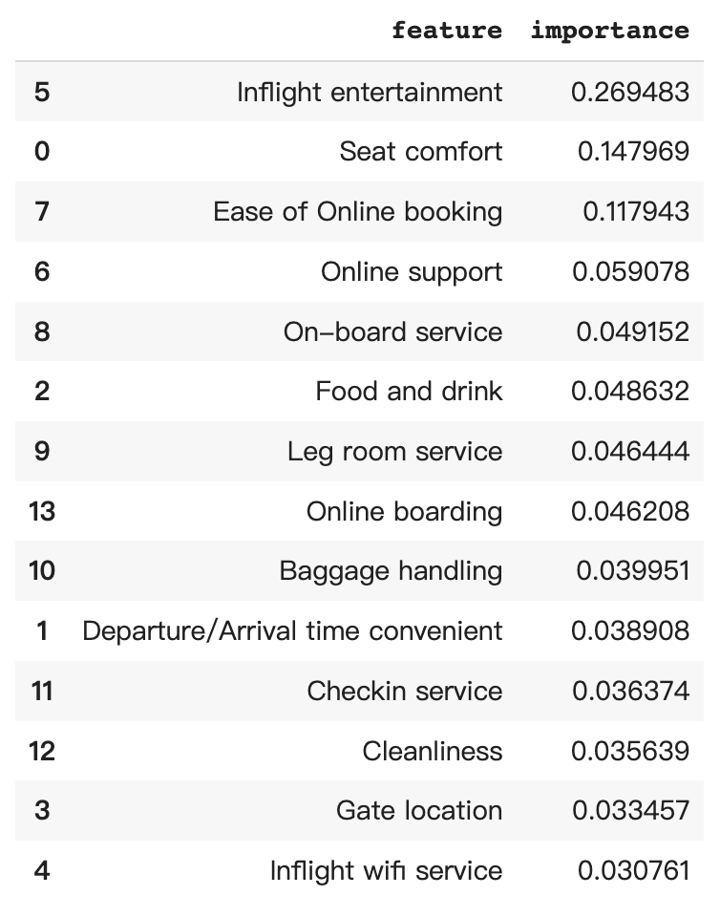
Model Prediction 2 - Predict satisfaction

Slide 15
Model Prediction 3
Goal: We want to create models to predict the Customer Type and identify potential loyal customers for the airline.
Value being predicted: Customer Type
Predictors: Gender, Age, Travel Type, Class, Flight Distance, and Overall Satisfaction Score

Slide 16
Model Prediction 3 - Predict Customer Type
Model type | Scoring metric | Number of folds (Cross validation) | Resulting model score
Logic Regression | AUC | 3 | 0.8995
Random Forest | AUC | NA | 0.9419
GBT Regression | AUC | NA | 0.9374
Neural Network | AUC | 3 | 0.4807

Slide 17
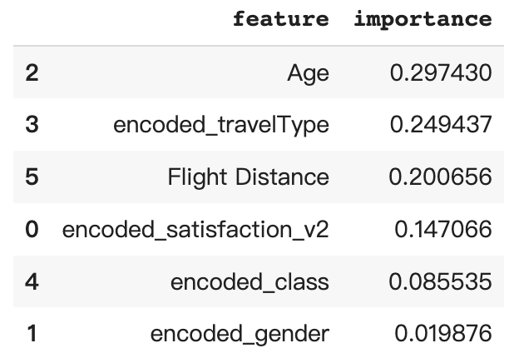
Model Prediction 3 - Predict Customer Type

Slide 18
Model Inference
When predicting overall satisfaction, we noticed that “Inflight entertainment”, “seat comfort” and “Ease of Online booking” are the top 3 metrics that are most important to satisfaction. Therefore, the airline are supposed to pay more attention to improve these three aspects to improve the service of airline.

Slide 19
Model Inference
We also calculated the coefficient of features when predicting the customer type. We wanted to get a picture of what a loyal member will look like. We found that “age”, “travel type”, and “flight distance” are top 3 features when predicting the customer type.

Slide 20
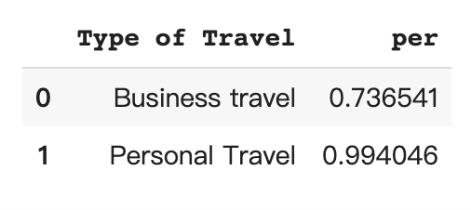
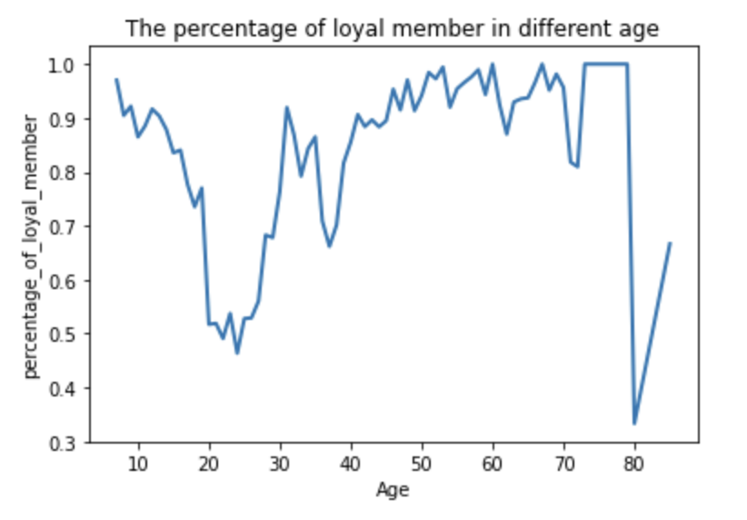
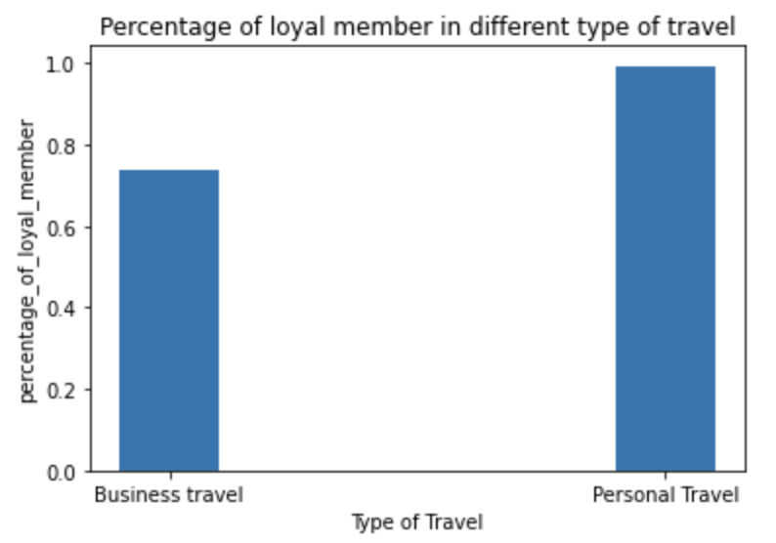
Model Inference

Slide 21

CONCLUSION

Slide 22
Results Summary
Decision tree is the best model to predict the overall satisfaction and customer type.
“Inflight entertainment”, “seat comfort” and “Ease of Online booking” are three aspects that the airline should pay more attention to and improve.
Passengers in 50-70 and with the purpose of personal travel are potential clients becoming loyal member.
The airline should also work harder to cooperate with companies.

Slide 23

I hope you enjoyed the presentation.
Thank you.

